Slide 1
Generic Team Name
Kory Clark, Sam Maxwell, Tanner Pflager, Nick Wilson,
Jared Zymbaluk

Slide 2
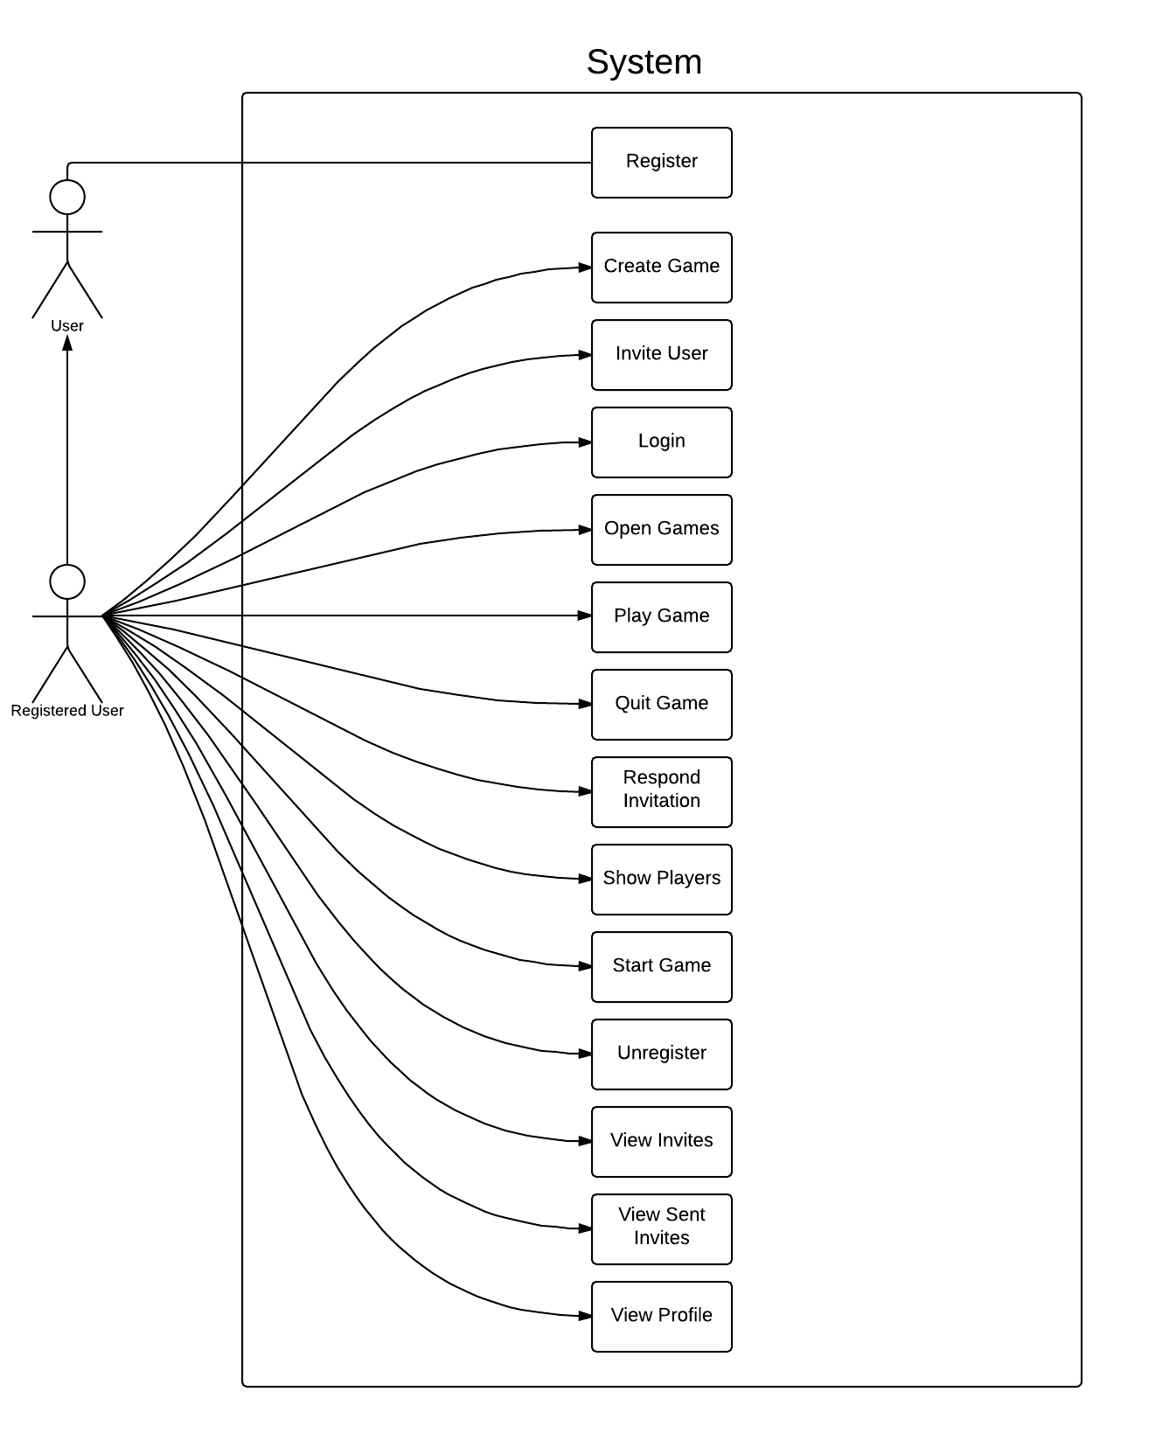
Use Case Updates
Added
Show Players
View Invites
View Sent Invites
Open Games

Slide 3
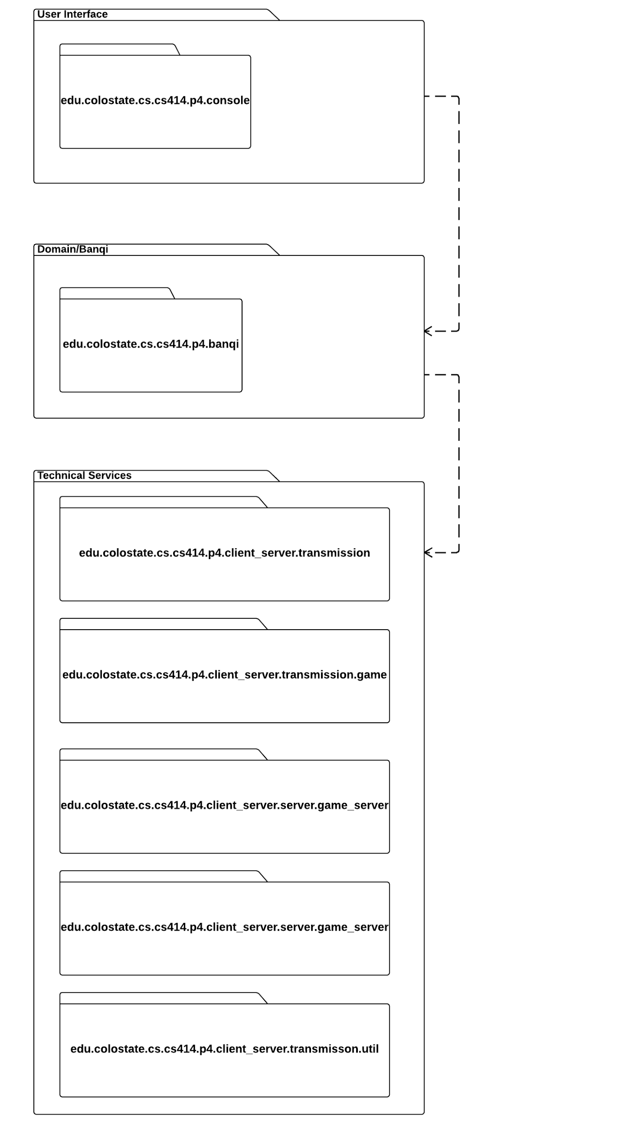
Package Diagram

Slide 4
Design Class Diagram
Updated Class Diagram

Slide 5
Development Manual
Development Manual

Slide 6
Refactoring Log & Design Pattern List
Refactoring Log
Added abstract methods
Refactored methods to only have one functionality
Added comments
Implemented GRASP/GoF patterns
Fixed errors in Banqi Game logic
Completed all Use Cases
Design Patterns Implemented
Factory Method
Singleton
Low Coupling
Polymorphism
Controller

Slide 7
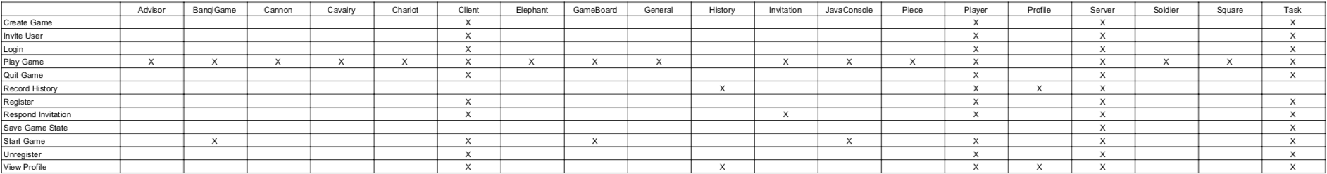
Traceability Link Matrix

Slide 8
Challenges and Lessons Learned
Challenges:
Learned about new grasp patterns and how to properly implement them.
Converting ideas into actual diagrams
Using software to make digital diagrams
Learning SQL
Lessons Learned:
How modeling can make the final code more organized
Hard to distribute work with a team

Slide 9

Demo Time!

